Slide 1
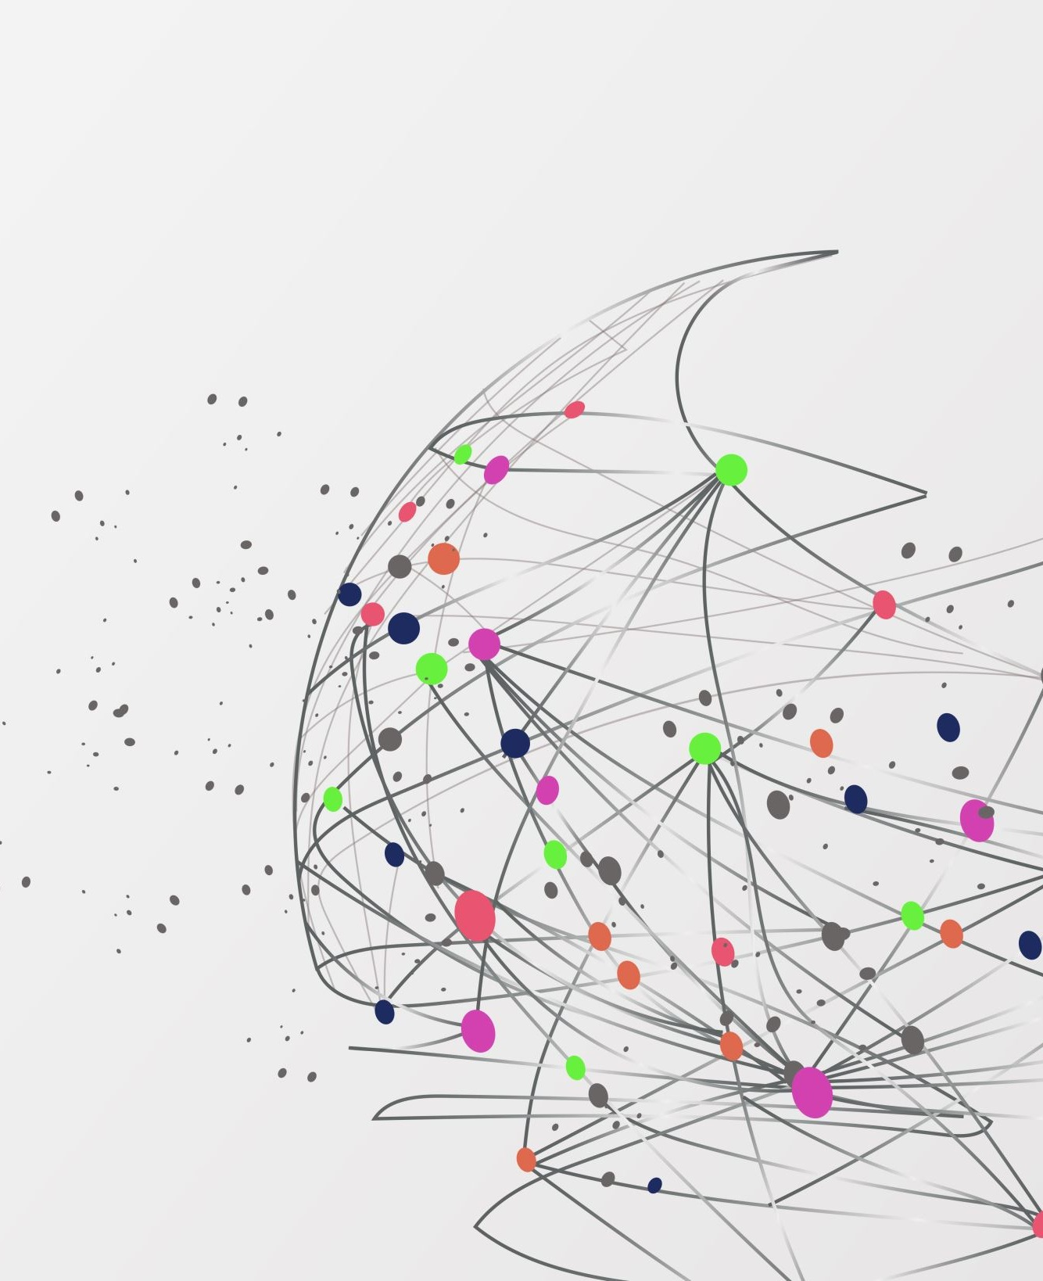
Finding and Getting Data
Data mining and extraction · Tuesday and Thursday

Slide 2
Where does data come from?
Source | Examples | Good for
Public repositories | Kaggle, UCI Machine Learning Repository | Practice and learning datasets
Government portals | Data.gov, US Census Bureau | Population, economy, environment
Data libraries | Datasets built into software (scikit-learn, Orange) | Quick and clean examples
APIs | Weather, maps and other online services | Fresh data that keeps updating
Your own collection | Surveys, logs, sensors, experiments | Questions nobody else has data for

Slide 3
Three kinds of source
Source | How the data arrives | Example | Watch out for
Database | Records kept on purpose | Game account table | Old, duplicated or inconsistent records
Sensor | Measured automatically | Ping time, temperature | Drift, gaps, impossible readings
Survey | People answer questions | Study-habits survey | Skipped questions, untruthful answers
Ask first: which of these three did this data come from?
Notes:
Three common sources. A database holds records an organization keeps on purpose: customer tables, hospital records, game accounts. A sensor measures the physical world automatically: temperature, ping time, a camera on a printer. A survey asks people questions, so the answers are what people say, not always what they do. Each source has its own typical problem, which is why we ask where the data came from before trusting it.

Slide 4
Structured and unstructured data
Structured
Rows and columns with named columns. Ready for Orange.
Example: a CSV of players.
Unstructured
No fixed table: text, photos, audio, video.
Example: 1,000 game reviews.
Unstructured item | One way to make it a table
A written review | Count words, or label it Positive or Negative
A photo | Measure size, brightness, or label what is in it
Notes:
Structured data fits in rows and columns with named columns, so Orange can load it right away. Unstructured data has no fixed table: free text, photos, audio, video. Unstructured data must be turned into numbers or labels before it can go into a table, for example counting words in a review or measuring the brightness of an image. In this course we work almost entirely with structured data; mention unstructured so students know it exists and where augmentation (text and image slides later) fits.

Slide 5
A good source and a weak source
Good source
Names the author or organization
Explains how the data was collected
Shows a date and a version
States the license clearly
Can be traced to the original
Weak source
Nobody is named
No description of the columns
No date, or very old
Copied from elsewhere with no link
Unclear if you may use it

Slide 6
Five questions to ask a source
Ask | Why it matters
Who made it? | A known organization is easier to check and to trust.
How was it collected? | A survey of 20 friends does not describe a whole country.
When was it made or updated? | Old data may describe a world that has changed.
Why was it made? | A company may only show numbers that make it look good.
Am I allowed to use it? | The license tells you what you may do with it.

Slide 7
Even a good source can have bad data
Missing values
Income left blank, or 999 meaning “no answer”.
Out of date
A 2010 table used to describe 2026.
Biased sample
An online poll only hears from people who answer online polls.
Mixed units
Some rows in feet, others in meters.
Duplicates and typos
The same sale listed twice. “NY” and “New York”.
Changed meaning
A column means one thing in 2015 and another in 2020.
A trusted source is not a clean dataset. Always look at the data first.

Slide 8
Four ways a sample goes wrong
Bias | What happens | Example
Cherry-picked data | Only rows that fit the story are kept | Showing only the best week of sales
Nonresponse | Many people asked never answer | 10% reply; they differ from the rest
Voluntary response | People choose to take part | An online poll: only the angry vote
Interviewer bias | The asker changes the answer | "You enjoyed the course, right?"
A big sample does not fix a biased sample.
Notes:
Sampling bias: the rows we have are not a fair picture of the group we care about. Four named kinds. Cherry-picked data: someone chooses only the rows that support the story. Nonresponse: many people asked do not answer, and the ones who do differ from the ones who do not. Voluntary response: people choose to take part, so mostly those with strong opinions respond. Interviewer bias: the way the person asking behaves or words the question changes the answer. This is Essential outcome 5.4, so say the names out loud and have students use them.

Slide 9
Which bias is it?
Situation | Which bias?
A game company reads only the reviews people chose to post. | Voluntary response
200 players got a survey and 20 answered. | Nonresponse
A chart shows only the 3 months when churn was low. | Cherry-picked data
A teacher asks "Don't you agree this class is fun?" | Interviewer bias
Name the bias first. Then say how to fix it.
Notes:
Practice. Let students name the bias before showing the right column. 1: voluntary response. 2: nonresponse. 3: cherry-picked data. 4: interviewer bias. Ask for a fix too: random sampling, follow-up reminders, showing all the data, neutral wording.

Slide 10
How to get a dataset
Direct download
Click a link and save a file, usually CSV or Excel.
Example
Kaggle, UCI, Data.gov
Watch out
Read the description and license first. Kaggle needs a free account.
API
A website lets a program ask for data in a standard format.
Example
Today’s weather for Dayton
Watch out
Often needs a key, and limits how many requests you can make.
Data library
Datasets packaged inside software.
Example
scikit-learn’s built-in datasets (like Iris), Orange’s example data
Watch out
Small and already cleaned. Real data is messier.

Slide 11
How an API works
Request
Request
You
Orange, a browser or a program
API
The waiter
Server
The kitchen with the data
Response
Response
Example: “Give me today’s weather for Dayton.” → a table of temperature, rain and wind.

Slide 12
A checklist for a good dataset
Check | Ask yourself
Accessible format (CSV) | Can I open it in Excel or Orange right away?
Clear column names | Is the column called “Age” and not “X7”?
Consistent and low noise | Same units and spelling in every row? Few errors?
Enough rows | Are there enough rows to see a pattern?
Clear metadata | Is there a description of what each column means?
Permissive license | Does the license say I may use it this way?

Slide 13
Good dataset vs bad dataset
Good dataset
Bad dataset
Student | Hours studied | Exam score
Ava | 5 | 78
Ben | 3 | 65
Chen | 8 | 91
Dana | 6 | 84
c1 | c2 | val
NY | 2019 | 12.5
New York | 2019 | 12.5
ny | 2020 | -
LA | 20/21 | 99999
Clear names, same units, no gaps. Described, open license.
Unclear names, mixed spellings, odd values. No description, license unknown.
With a neighbor: which checklist items does each dataset pass or fail?

Slide 14
Use data responsibly
License
Free to download is not free to use for anything. Read the license.
Privacy
Names, emails and locations are about real people. Do you have consent?
Terms of service
Some websites do not allow you to copy their data.
Fairness
Who is missing from the data? Who might be harmed by it?

Slide 15
Data augmentation
Used for: class imbalance
One group has far fewer examples, like fraud or a rare defect.
What it is
Making new, slightly changed examples from the data we already have.
Synthetic data is made by a program, not collected from the world.
Used for: overfitting
A model memorizes a small dataset instead of learning the pattern.
Class imbalance: one group has far fewer examples than another.
Overfitting: a model memorizes its practice data, then fails on new data.

Slide 16
Why we augment data
Fix class imbalance
Give the rare group enough examples to learn from.
Reduce overfitting
More variety, so the model learns the pattern.
Handle messy real life
Photos are tilted, and people word things differently.
Small datasets
Only a few hundred rows? Augmentation adds variety.
Save time and money
Collecting more real data can be slow or costly.

Slide 17
Why class imbalance is a problem
Always guess “not spam”?
95% accurate.
0 spam emails found.
Accuracy hides the problem.
Fix: give the model more spam examples to learn from.

Slide 18
Class imbalance in real life
Situation | Common class | Rare class (we care) | Rough split
Card payments | Normal purchase | Fraud | 999 : 1
Factory parts | Good part | Defective part | 98 : 2
Email | Not spam | Spam in the inbox | 95 : 5
Machine sensors | Running fine | About to fail | 99 : 1
Course records | Passed | Dropped out | 90 : 10

Slide 19
Why imbalance fools a model
The model mostly sees the common class.
1,000 payments | Model said normal | Model said fraud
990 really normal | 990 | 0
10 really fraud | 10 | 0
Always guessing “common” already scores high.
“Always normal” model
Accuracy: 99%
Fraud caught: 0 of 10
The rare cases are missed, and they matter most.

Slide 20
Four ways to handle imbalance
Collect more
Get more real rare examples. Best, but often hard.
Augment the rare class
Make new rare examples (SMOTE, ADASYN).
Remove common rows
Use fewer common rows. Loses real data.
Better measures
Count the rare cases caught, not just accuracy.

Slide 21
What overfitting means
Overfitting
Great on practice data.
Poor on new data.
The model memorized instead of learned.
Fix: add variety so memorizing stops working.
Notes:
The numbers are made up. Overfitting means the model does very well on the data it practiced on but poorly on new data, because it memorized the practice data instead of learning the pattern. Compare it to a student who memorizes the answers to one practice test and then fails the real exam. This is the second big reason we augment data. We measure it properly with train and test sets in Week 7.

Slide 22
Overfitting in real life
Situation | What it memorized | What goes wrong
Exam study | Answers to one practice test | Fails a new test
Face unlock | 20 photos in one room | Fails in new lighting
Spam filter | Exact words of old emails | Misses reworded spam
Grade predictor | Student ID numbers | No pattern for new students
Defect detector | Parts from one machine | Fails on other machines
Notes:
Each row is a made-up but realistic case of memorizing instead of learning. The grade predictor row is the same trap as a Player ID or Student ID column: the model can memorize it, but it tells us nothing about new people. Ask students for an example from their own life, like cramming one practice test.

Slide 23
Why small datasets overfit
The model sees only a few examples.
Model | Practice data | New data
Memorizer | 100% | 62%
Pattern learner | 91% | 89%
It memorizes their quirks and noise.
Look at the gap
Memorizer: 38 points lower on new data
Pattern learner: 2 points lower
New data looks different, so it fails.
Notes:
Walk through the table. With only a few examples, a model can memorize every one of them, even the quirks and noise. The memorizer scores 100 percent on practice data but only 62 percent on new data, a gap of 38 points. The pattern learner scores a little lower on practice data but almost the same on new data. A big gap between practice and new data is the warning sign of overfitting. Numbers are made up.

Slide 24
Four ways to reduce overfitting
Collect more
Get more real examples. Best, but often costly.
Augment the training data
Add varied copies so memorizing stops working.
Use fewer columns
Drop IDs and repeated columns (Weeks 5 and 6).
Check on new data
Compare practice and new scores (Week 7).
Notes:
Augmentation is one of four fixes. Using fewer, better columns comes back in Weeks 5 and 6 as the rule of thumb that more columns is not always better. Checking on new data is how we notice overfitting at all, and we do it properly in Week 7 with train and test sets.

Slide 25
Techniques by data type
Data type | Technique | Plain idea | Helps with
Tables | SMOTE | Synthetic Minority Over-sampling Technique: creates new rows between two real rare rows. | Class imbalance
Tables | ADASYN | Adaptive Synthetic sampling: like SMOTE, with more new rows where learning is hardest. | Class imbalance
Tables | Noise injection | Adds a tiny random wiggle to numbers (70.0 becomes 70.3). | Overfitting
Text | Back-translation | Translate to another language and back to get new wording. | Overfitting
Text | Synonym replacement | Swap words for similar ones (“big” becomes “large”). | Overfitting
Images | Colors, angles, cropping | Flip, rotate, crop or recolor the same picture. | Overfitting
Notes:
SMOTE stands for Synthetic Minority Over-sampling Technique. ADASYN is Adaptive Synthetic sampling. Both create new rows for the rare class. Noise injection adds a tiny random change to the numbers. Back-translation and synonym replacement are for text. Images can be flipped, rotated, cropped and recolored. Say each full name aloud when you introduce the acronym. The last column shows the main goal: SMOTE and ADASYN fix class imbalance, while noise, text and image changes add variety so a model overfits less (they also help a little with imbalance if applied to the rare class). Students do not need to run these; they need to know that they exist and what each one does.

Slide 26
SMOTE: make new rare rows
What it does
Creates new rare rows between two real rare rows.
Why use it
Balances the classes without copying rows.
Watch out
The new row is a blend, not a real case.
● common ● rare (real) ○ new (synthetic)
Example: rare A = (2, 4), rare B = (4, 8). Halfway = (3, 6) = new row.

Slide 27
ADASYN: more help where it is hard
What it does
Like SMOTE, but adds more rows where the rare class is hard.
Why use it
Helps most at the border between the two groups.
Watch out
Can also copy noise or mistakes near the border.
● common ● rare (real) ○ new (synthetic)
Rare points close to common ones get more new points.

Slide 28
Noise injection: small wiggles
What it does
Adds a tiny random change to each number.
Row | Temp (°C) | Price ($)
Original | 70.0 | 4.99
New copy 1 | 70.3 | 5.02
New copy 2 | 69.8 | 4.97
Why use it
Makes copies that are similar, not identical.
Watch out
Too much noise makes impossible rows.
Same meaning, tiny difference. Works for numeric columns only.

Slide 29
Back-translation: new wording
What it does
Translates a sentence to another language and back.
English (original)
The movie was great.
translate
Why use it
Gives new wording with the same meaning.
Spanish (middle step)
La película fue genial.
translate back
Watch out
Translations can slip. Read some results.
English (new version)
The film was really good.

Slide 30
Synonym replacement: swap words
What it does
Swaps a few words for similar words.
Original (positive review)
The food was good and the service was fast.
Why use it
Quick and cheap way to get new sentences.
New version (still positive)
The meal was great and the service was quick.
Watch out
Words with two meanings can change the sense.
Changed words are shown in green.

Slide 31
Images: rotate and flip
What it does
Tilts or flips the picture by a small angle.
F
F
F
F
Why use it
The model learns objects seen from many angles.
Original
Tilt 15°
Tilt −15°
Upside down
Watch out
Some turns change meaning, like 6 and 9.
Warning: a 6 upside down looks like a 9, so the label would be wrong.

Slide 32
Images: cropping
What it does
Cuts out a different part of the same picture.
Crop 1
Crop 3
Crop 2
Why use it
The object can sit anywhere in the frame.
Watch out
Do not crop out the thing you are labeling.
Each crop is a new picture of the same scene.
Notes:
Cropping cuts out a part of the picture. The model learns that an object can appear in different positions and sizes, and that it should not rely on one corner of the picture. Do not crop so tightly that the object disappears.

Slide 33
Images: change colors
What it does
Changes brightness, tint or turns the picture gray.
Why use it
Photos are taken in different light and cameras.
Original
Brighter
Darker
Gray
Watch out
Do not do it when color is the clue (ripe fruit).
Same subject, different lighting. The label does not change.

Slide 34
Augmentation: do and don’t
Do
Augment the training data only, never the test data.
Keep labels true: a rotated 6 can look like a 9.
Keep the original data too.
Check that new examples look realistic.
Don’t
Treat synthetic rows as new facts. They add variety, not information.
Use it to rescue a tiny, poor dataset.
Create impossible rows, like a 300-year-old customer.

